Slide 1
Angular Routing
Deborah Kurata
@deborahkurata http://blogs.msmvps.com/deborahk deborahk@insteptech.com
Notes:
"An Angular application often displays a view for each of the many business operations including selection, review, and editing. And as soon as you have more than one view, you need a way to navigate between them. This session demonstrates how to define, configure, and navigate Angular routes to display multiple views. First, we look at the available routing frameworks: ngRoute and UI Router, each with their own approach to routing. Then we dive deeper with step-by-step demonstrations of implementing routing based on application state."

Slide 2
Deborah Kurata
Independent Consultant | Developer | Mentor
Web (Angular), .NET
Pluralsight Author
AngularJS Line of Business Applications
Angular Front to Back with Web API
Object-Oriented Programming Fundamentals in C#
Microsoft MVP

Slide 3
Session Materials & Sample Code
https://github.com/DeborahK/ab2015

Slide 4
Rate Yourself on Routing
New to Angular - no proficiency
Just starting out - limited proficiency
Doing it but not fully understanding it - working proficiency
Been there, done that, can help others - full proficiency

Slide 5

Overview
SPA
Routing
Routing Frameworks
ngRoute
ngNewRouter

Slide 6
Demo: Angular in Action
Notes:
Product Management
Point out how the navigation works.
And how the nested views look.
2) Movie Hunter
Point out the simple navigation.
This is the code we will look at in this session

Slide 7
SPA
Single Page Application
Only one page?
Only one full HTML page
All other pages are HTML fragments called templates
And are displayed within the one HTML page
Goals:
Enhance user experience
Reduce round tripping
Notes:
"Template" or sometimes "layout template"

Slide 8

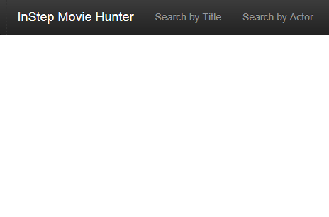
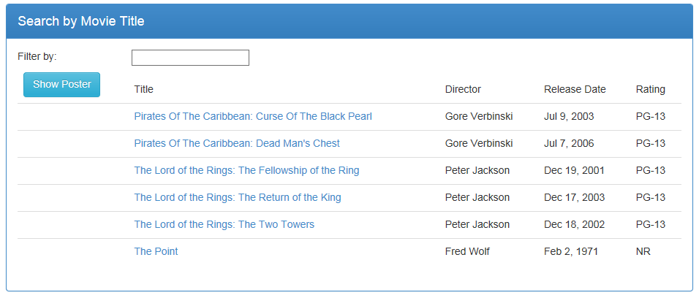
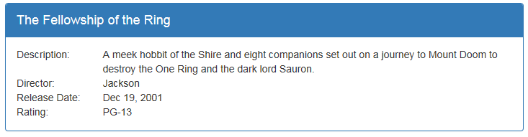
Multiple Views
Notes:
Most Web applications are more than one page.
- Define each view in its own html file.
Define the header, menu, footer in the index.html.
Define the ng-view directive in the location in the HTML where the views should appear.

Slide 9
Routing
Technique for navigating between views
Each route represents a specific view
Activating a route navigates to that view
Routes defined by rules

Slide 10
Routing Frameworks
ngRoute
UI Router
ngNewRouter
Notes:
ngRoute
Is the original routing framework provided by Angular.
It provides for simple, straight-forward routes.
UI Router
Is a third-party routing package.
It has more advanced features than ngRoute including
Nested views, as we saw with the tab pages in the Product Management application we looked at.
ngNewRouter
Is the new router that is coming out in Angular 1.4
And is expected to be the router for Angular 2.0.
It provides the ease of use of ngRoute
With many of the more advanced features from UI Router.
Though the syntax will be slightly different, the concepts are the same for each of the three frameworks

Slide 11
ngRoute
Available from
https://angularjs.org/
angular-route.js
Based on
URL fragment identifiers
Each route has
URL fragment identifier
View template
Optional Controller
Angular Web Site
http://localhost:64492/index.html#/searchByTitle

Slide 12
UI Router
Available from
https://github.com/angular-ui/ui-router
angular-ui-router.js
Based on
Application states
Each state has
Optional URL fragment identifier
View template
Optional Controller
Third-party Angular UI Library

Slide 13
ngNewRouter
Available from
https://github.com/angular/router
Router.es5.js
Based on
URL fragment identifiers
Each route has
URL fragment identifier (path)
Component
Angular 1.4
http://localhost:64492/index.html#/searchByTitle

Slide 14
ngRoute
https://docs.angularjs.org/api/ngRoute
Notes:
We'll first look at the Angular module: ngRoute.

Slide 15
Site Map
Welcome Page
Movie Detail
Movie List
Menu
Movie Edit
Notes:
An easy way to picture the routing is to look at a site map.

Slide 16
Routes
Welcome Page
/showDetail/3
Movie Detail
/
/searchByTitle
Movie List
/editMovie/3
Menu
Movie Edit
/editMovie/0
Notes:
Each view in the map can then be associated with a named route.

Slide 17
Routing URL Fragments
<mysite>/index.html#/
<mysite>/index.html#/searchByTitle
<mysite>/index.html#/showDetail/3
Notes:
Define the ng-view directive in the location in the HTML where the views should appear.
ng-viewport in the new Angular router.

Slide 18
ngRoute: index.html
<div class="container">
<div ng-view></div>
</div>
Notes:
- By convention, the "single page" of the application is defined in index.html.
- In the index.html file, define the header, menu bar, and footer.
- And use the ng-view directive to identify where the HTML templates for the views should appear.
ng-view includes the rendered template of the current route into the main layout.
Every time the route changes, the included view changes with it according to the route configuration.

Slide 19
Routes
Welcome Page
/showDetail/3
Movie Detail
/
/searchByTitle
Movie List
Menu
Movie Edit
/editMovie/3

Slide 20
ngRoute: app.js
var app = angular.module("movieHunter", ["ngRoute"]);
app.config(['$routeProvider',
function ($routeProvider) {
$routeProvider
.when("/", {
templateUrl: "app/welcomeView.html"
})
.when("/searchByTitle", {
templateUrl: "app/movies/movieListView.html",
controller: "MovieListCtrl as vm"
})
.when("/showDetail/:movieId", {
templateUrl: "app/movies/movieDetailView.html",
controller: "MovieDetailCtrl as vm"
})
.otherwise("/");
}]);
Notes:
$routeProvider is the provider for the $route service.
Providers create and provide instances of services and expose configuration APIs.
Providers can only be injected into config functions.
Everyone know what "controller as" means?
NOTE: I cut the edit view off of this code so it would fit in the slide.

Slide 21
Navigation
Anchor tags
Link to the appropriate route
<a ng-href="#searchByTitle">
$location service
$location.path("/searchByTitle");
Notes:
To navigate to a view, activate its route.

Slide 22
ngRoute: index.html
<div class="navbar-collapse collapse">
<ul class="nav navbar-nav">
<li>
<a ng-href="#searchByTitle">Search by Title</a>
</li>
<li>
<a ng-href="#editMovie/0">
<i class="glyphicon glyphicon-plus"></i>
Add Movie
</a>
</li>
</ul>
</div>

Slide 23
ngRoute: movieDetailView.html
<div class="panel-footer">
<a class="btn btn-default"
ng-href="#searchByTitle"
style="width:80px">
<i class="glyphicon glyphicon-chevron-left"></i>
Back
</a>
<a class="btn btn-primary"
ng-href="#editMovie/{{vm.movie.movieId}}"
style="width:80px;margin-left:10px">
Edit
</a>
</div>

Slide 24
Demo: ngRoute
Notes:
Show the app.js file.
Show the index.html file
Show the movieDetailView.html file.
Show the movieEditView.html file.

Slide 25
ngNewRouter
https://github.com/angular/router
https://angular.io/
Notes:
Now let's take a quick look at ngNewRouter
- This is the router coming out in Angular 1.4 and used in Angular 2.0

Slide 26
ngNewRouter: index.html
<div class="container">
<div ng-viewport></div>
</div>
Notes:
ng-viewport directive instead of ng-view
Defines where the content is displayed

Slide 27
ngNewRouter : app.js
var app = angular.module("movieHunter", ["ngNewRouter"]);
app.controller('AppController', ['$router', AppController]);
function AppController ($router) {
$router.Config([
{ path: '/', component: 'welcome' },
{ path: '/searchByTitle', component: 'movieList' },
{ path: '/showDetail/:movieId', component: 'movieDetail' },
{ path: '/editMovie/:movieId', component: 'movieEdit' }
]);
}
Notes:
Things to notice here:
Dependency on ngNewRouter
We define a controller instead of using the .config.
The router config takes an array of pairings (path and component)
The paths map to routable components
The route is a named component with an aliased function
NOTE: The new router enforces the "controller as" syntax!

Slide 28
Routable Component in 1.4+
Defined by the directory structure
Or configure with
$componentLoader
components/
welcome/ welcome.html
movieList/ movieList.html movieList.js
movieEdit/ movieEdit.html movieEdit.js
Notes:
Or configure in the $componentLoader service
Best practice: Define each component in a separate module.
Once the Angular team implements lazy loading, it will be possible to delay loading of the module until it is requested

Slide 29
ngNewRouter: movieDetailView.html
<div class="panel-footer">
<a class="btn btn-default"
ng-link="movieList"
style="width:80px">
<i class="glyphicon glyphicon-chevron-left"></i>
Back
</a>
<a class="btn btn-primary"
ng-link="movieEdit({movieId: vm.movie.movieId})"
style="width:80px;margin-left:10px">
Edit
</a>
</div>
Notes:
ng-link directive navigates to the route component.
Link to the *component* not the path.
Notice the difference in syntax for the link to movieEdit.
This uses a function expression.
The movieId is passed as an argument.

Slide 30
Multiple Viewports: Sibling Components
<div ng-viewport="master"></div>
<div ng-viewport="detail"></div>
var app = angular.module("movieHunter", ["ngNewRouter"]);
app.controller('AppController', ['$router', AppController]);
function AppController($router) {
$router.config([
{ path: '/showDetail/:movieId',
component:
master: 'movieList',
detail: 'movieDetail' }
]);
}
Notes:
Multiple viewports allows us to display multiple views within the index.html file.
Other examples:
- Separating application header from the menu

Slide 31
Child Views
<div class="panel-body">
<div class="wizard">
<a ng-link="movie">
Movie Details
</a>
<a ng-link="actors">
Actors
</a>
<a ng-link="tags">
Search Tags
</a>
</div>
<div ng-viewport></div>
</div>
Notes:
Add a ng-viewport inside a view.

Slide 32
Lifecycle Hooks
canActivate
Before switch to component
Example: authorization
MovieEditController.prototype.canActivate = function() { return this.user.isAdmin; };
activate
Before navigation finishes
Example: retrieve data
MovieEditController.prototype.activate = function() { return movieResource.get(…); };
Notes:
Lifecycle hooks allow you to control each state of a route navigation.
Use "activate" for "resolve" features??

Slide 33
Lifecycle Hooks (cont)
canDeactivate
Before switch to component
Example: ensure data is saved
MovieEditController.prototype.canDeactivate = function() { return this.isDataSaved; };
deactivate
Before switch to component
Example: clean up work
MovieEditController.prototype.deactivate = function() { return ...; };

Slide 34
Lifecycle Hooks Sequence
canDeactivate
canActivate
deactivate
activate
Notes:
Lifecycle hooks allow you to control each state of a route navigation.
Use canActivate for authorization features
Use "activate" for "resolve" features??
Use canDeactivate to ensure data is saved.

Slide 35
Demo: ngNewRouter
https://github.com/angular/router/tree/master/examples/angular-1/wizard
Notes:
Show directory structure
Show each page.
Show canActivate

Slide 36
Which to Use?
Use ngNewRouter
If you can use Angular 1.4
And are OK with the directory structure (or $componentLoader service)
Use ngRoute
If app is <1.4
And only need simple routing
Use ui-Router
If app is <1.4
And you need complex routing (nesting, etc)

Slide 37
Thank You!
@deborahkurata
deborahk@insteptech.com
http://blogs.msmvps.com/deborahk
https://github.com/DeborahK/ab2015

